Slide 1
Intro to C#
Lec 1

Slide 2
Class and Object
Think of objects as software representations of tangible things (ships, asteroids, weapons, projectiles, etc.)
State
Characteristics of the object
Behavior
What we can do to the object
What we can tell the object to do to itself
Identity
Distinguish one object from another
Notes:
Identity
So we can distinguish one object from another
Memory address

Slide 3
Class and Object
Class
Template for creating objects
Defines the fields, properties, and behavior of every object of the class
Object
Actual instance of the class in memory
Each object stores its own state
Different card objects have different ranks and suits, for example

Slide 4
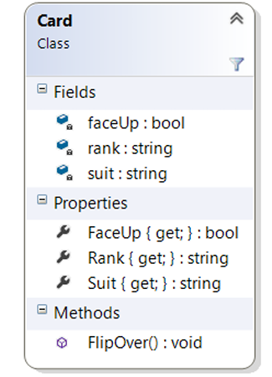
Card Class
Playing Card
State: rank, suit, face up or not
Stored in fields
Accessed through properties
Behavior: flip over
Accessed through methods
Identity: when we create a new card object (instantiation)
UML
Doc: https://drive.google.com/file/d/1Jr3ufbcUSSa3pqyxtphguYWzEV2RGYoe/view?usp=sharing

Slide 5
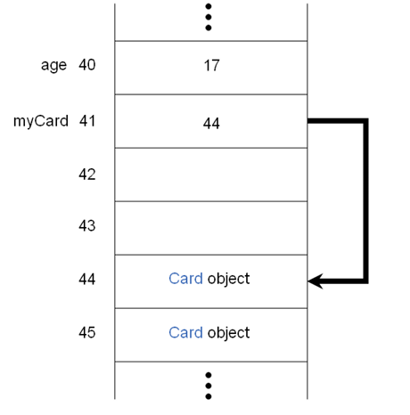
Object Reference
Value types hold the value
Reference types point to a different location in memory

Slide 6
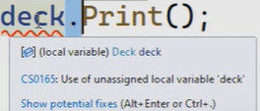
Deck class
Deck deck;
deck.print();
Any problem?

Slide 7
Deck class - Constructor
Deck deck = new Deck();
deck.Print();
Card.dll
https://drive.google.com/file/d/1QJ59fKr6LZHJZOz5psg3eEC1Ek6WHWiS/view?usp=sharing

Slide 8
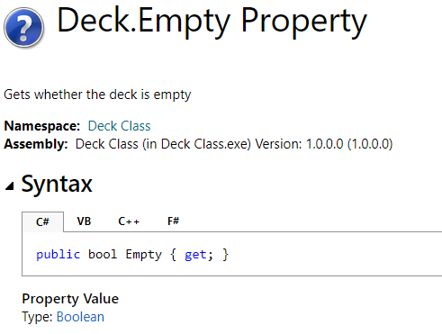
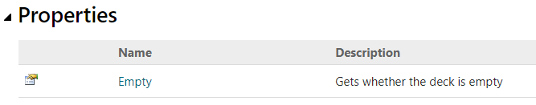
Properties in C#
Show the properties of Deck class
bool isEmpty = deck.Empty;
Function/method or property?

Slide 9
Optional: Property in C++
struct Foo {
// Properties using unnamed classes.
class {
int value;
public:
int & operator = (const int &i) { return value = i; }
operator int () const { return value; }
} alpha; //object of the class
class {
float value;
public:
float & operator = (const float &f) { return value = f; }
operator float () const { return value; }
} beta; //object of the class
};
int main () {
Foo foo;
foo.alpha = 5;
foo.beta = 5.132f;
::std::cout << foo.alpha << ", "
<< foo.beta << ", "
<< ::std::endl;
https://replit.com/@crimson2000/propertyExample#main.cpp

Slide 10
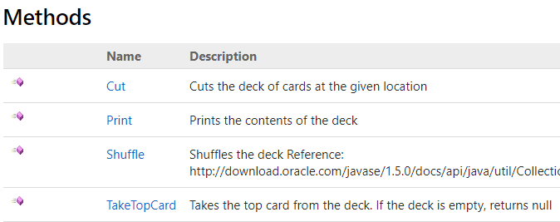
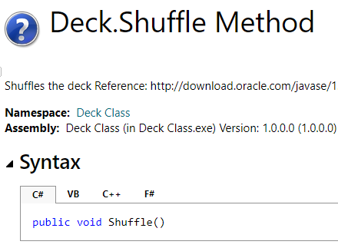
Method
//Call a method Shuffle
deck.Shuffle();
deck.Print();

Slide 11
Exercise
Write code to
create a new deck and tell the deck to print itself
tell the deck to shuffle and print itself
take the top card from the deck and print the card rank and suit (check Card class for rank and suit)
take the top card from the deck and print the card rank and suit
Cut the deck of cards at a random position
print all cards in the deck
Doc: https://drive.google.com/file/d/1Jr3ufbcUSSa3pqyxtphguYWzEV2RGYoe/view?usp=sharing

Slide 12
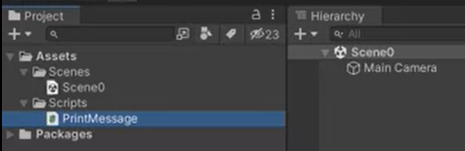
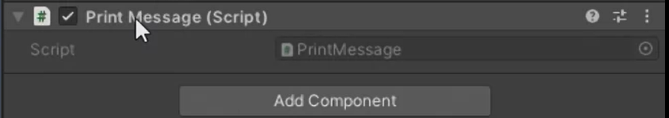
Unity 3D - Object and Class

Slide 13
For loop
for (statement 1; statement 2; statement 3)
{
// code block to be executed
}
for (int i = 0; i < 5; i++) {
Console.WriteLine(i);
}

Slide 14
Exercise
Repeat the following task for 5 times
take the top card from the deck and print the card rank and suit
Print value of the each card, e.g. Ace as 1, 2-10: The value is the same as the number on the card. Jack: Valued as 11. Queen: Valued as 12. King: Valued as 13.

Slide 15
For-each
foreach (type variableName in arrayName)
{
// code block to be executed
}
string[] cars = {"Volvo", "BMW", "Ford", "Mazda"};
foreach (string car in cars) {
Console.WriteLine(car);
}

Slide 16
Exercise
Repeat the following task for 5 times
take the top card from the deck and print the card rank and suit
Print value of the each card, e.g. Ace as 1, 2-10: The value is the same as the number on the card. Jack: Valued as 11. Queen: Valued as 12. King: Valued as 13.
Check the method ‘Print’ in Deck.cs

Slide 17
While loop
while (condition) {
// code block to be executed
}
int i = 0;
while (i < 5) {
Console.WriteLine(i);
i++;
}

Slide 18
Exercise
Repeat the following task for 5 times
take the top card from the deck and print the card rank and suit
Print value of the each card, e.g. Ace as 1, 2-10: The value is the same as the number on the card. Jack: Valued as 11. Queen: Valued as 12. King: Valued as 13.
Check the method ‘Print’ in Deck.cs
Reimplement the task 1

Slide 19
If else statement
if (condition1) {
// block of code to be executed if condition1 is True
}

Slide 20
If else
if (condition1) {
// block of code to be executed if the condition1 is false and condition2 is True
}
Else {
// block of code to be executed if the condition1 is false and condition2 is False
}

Slide 21
If else
if (condition1) {
// block of code to be executed if condition1 is True
}
else if (condition2) {
// block of code to be executed if the condition1 is false and condition2 is True
}

Slide 22
If else
if (condition1) {
// block of code to be executed if condition1 is True
}
else if (condition2) {
// block of code to be executed if the condition1 is false and condition2 is True
}
Else {
// block of code to be executed if the condition1 is false and condition2 is False
}

Slide 23
Exercise
Repeat the following task for 5 times
take the top card from the deck and print the card rank and suit
Print value of the each card, e.g. Ace as 1, 2-10: The value is the same as the number on the card. Jack: Valued as 11. Queen: Valued as 12. King: Valued as 13.
Check the method ‘Print’ in Deck.cs
Reimplement the task 1
Measure how many even numbers and odd numbers of the first 5 cards (the task 1)

Slide 24
HW 1-a
Download the hw1.zip and unzip it
https://drive.google.com/file/d/1YaY2vCVK_Jjd3YesXlNV_CdDPYkkwwwo/view?usp=sharing
Replace the program.cs in the project exercise 1 with the above code
Follow the instructions to complete the implementation

Slide 25
HW 1-b
Create a new Console Application project named Exercise10. Save the project in a reasonable location on the computer.
Create a menu of choices for your user. It should look like the following (without the extra blank lines added by the Coursera formatting):
**************
Menu:
1 - New Game
2 - Load Game
3 - Options
4 - Quit
**************

